Slide 1
Length of a shorter side
Geometrical properties: similarity and Pythagoras’ theorem

Slide 2
how to use Oak lessons

Slide 3
I can use Pythagoras’ theorem to find the length of one of the shorter sides.

Slide 4
A right-angled triangle has exactly one 90° interior angle.
A hypotenuse is the side of the right-angle triangle which is opposite the right-angle.
Pythagoras’ theorem shows that the sum of the squares of the two shorter sides of a right-angled triangle is equal to the square of its longest side (the hypotenuse).

Slide 5

Length of a shorter side
Squares from the sides of a triangle
Using Pythagoras’ theorem to find a shorter side

Slide 6
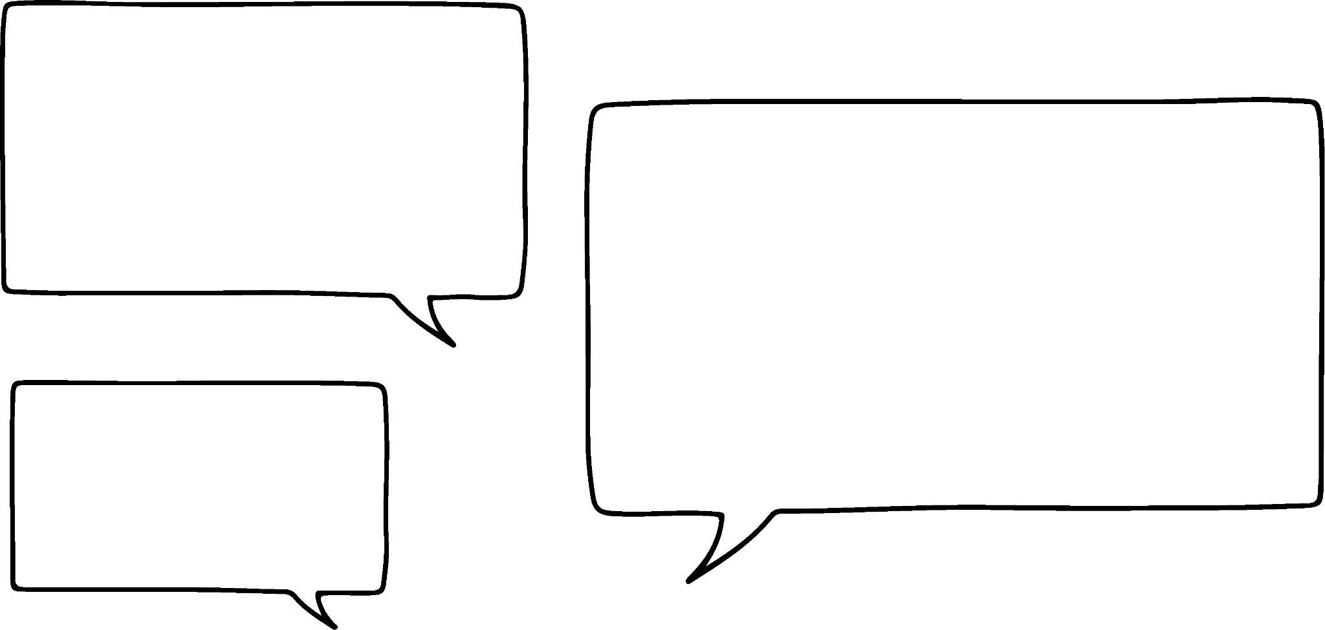
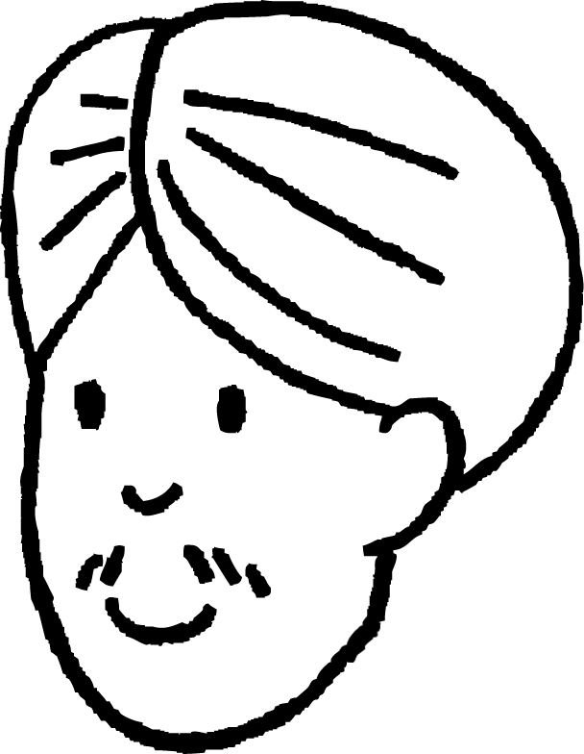

Squares from the sides of a triangle
We can draw squares onto each side of a triangle.
Oh, and we can find the length of the hypotenuse by square rooting the area of that square!
And square each side length to find the area of that square.
area
36 + 64 cm²
100 cm²
100
= 10
10 cm
Andeep
h cm
6 cm
area
36 cm²
6 cm
The area of the square from the hypotenuse is the sum of the two smaller squares from the shorter two sides of the triangle.
8 cm
area
64 cm²

Slide 7

Squares from the sides of a triangle
area
169 cm²
h cm
13 cm
9 cm
area
81 cm²
a cm
6 cm
6 cm
12 cm
12 cm
area
144 cm²
I can’t find the length of a using the same method, can I?
area
144 cm²
What’s different about these two diagrams?
Sam
Sam

Slide 8

Squares from the sides of a triangle
In this triangle, the square that doesn’t have its area labelled is the square from the hypotenuse.
area
81 + 144 cm²
225 cm²
15 cm
h cm
area
81 cm²
Therefore, the area of this square is the sum of the two other squares.
9 cm
6 cm
12 cm
And the length of the hypotenuse can be found by square rooting the area of this square.
area
144 cm²
225
= 15

Slide 9
Squares from the sides of a triangle
Whereas, in this triangle, the area of the square from the hypotenuse is known.
area
169 cm²
Therefore, the 169 is the sum of 144 and the area of square A.
169 = 144 + area of square A
13 cm
square A
a cm
6 cm
12 cm
So, how can I find the area of square A?
area
144 cm²
This square comes from one of the shorter sides of the triangle.
Sam

Slide 10
Squares from the sides of a triangle
Therefore, the 169 is the sum of 144 and the area of square A.
169 = 144 + area of square A
169 − 144 = 144 + area of square A − 144
area
169 cm²
area
25 cm²
13 cm
square A
a cm
6 cm
169 − 144 = area of square A
25 = area of square A
12 cm
area
144 cm²
The area of one of the squares from a shorter side of the triangle is found from subtracting, or finding the difference between, the areas of the two other squares.

Slide 11
Squares from the sides of a triangle
Therefore, the 169 is the sum of 144 and the area of square A.
169 = 144 + area of square A
area
169 cm²
− 144
− 144
area
25 cm²
13 cm
square A
a cm
5 cm
6 cm
169 − 144 = area of square A
25 = area of square A
12 cm
area
144 cm²
The length of that shorter side of the triangle is found in the same way.
25
= 5

Slide 12


Squares from the sides of a triangle
Which of these calculations finds the area of square B?
b cm
a
1681 + 1600
square
B
b
1681 − 1600
area
1681 cm²
c
41 + 40
d
41 − 40
area
1600 cm²
41 cm
40 cm

Slide 13
Squares from the sides of a triangle
Which of these statements helps explain why 1681 − 1600 is the correct calculation?
b cm
square
B
a
Square B is the square from the hypotenuse of the triangle.
area
1681 cm²
b
Square B is the square from a shorter side of the triangle.
area
1600 cm²
41 cm
40 cm

Slide 14
Squares from the sides of a triangle
What is the length of side b, in cm?
1681 − 1600 = 81
The area of square B is 81 cm²
b cm
square
B
81 = 9
area
1681 cm²
b is 9 cm long.
It is the length of the shortest side of the triangle.
area
1600 cm²
41 cm
40 cm

Slide 15
Squares from the sides of a triangle
Match the missing length or area to its correct value.
316
a
32
area
cm²
a
area
cm²
256
b
b
17.8
16 cm
c
cm
14
c
area
60 cm²
196

Slide 16
Squares from the sides of a triangle
Match the missing length or area to its correct value.
256
a
area
cm²
a
area
cm²
196
b
b
16 cm
14
c
cm
c
area
60 cm²
316
32
17.8

Slide 17
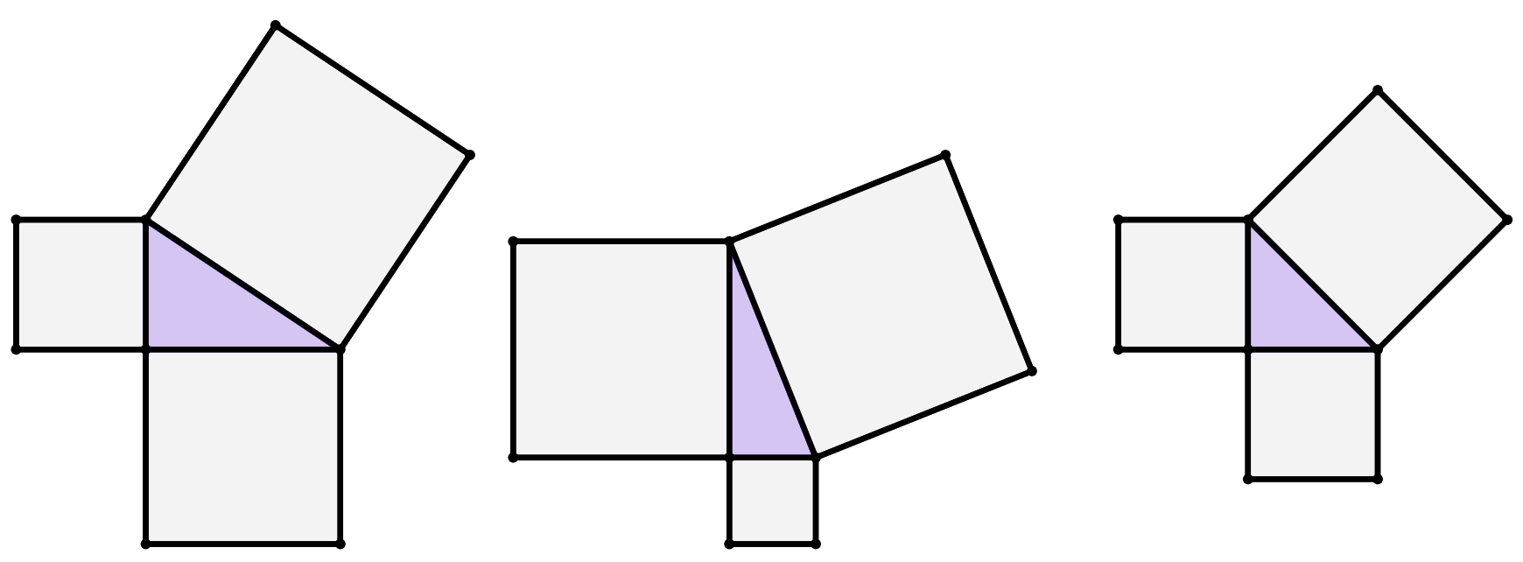
Squares from the sides of a triangle
1) Find the area of each unlabelled square.
29 cm
area
570 cm²
12 cm
20 cm
20 cm
area
30 cm²

Slide 18
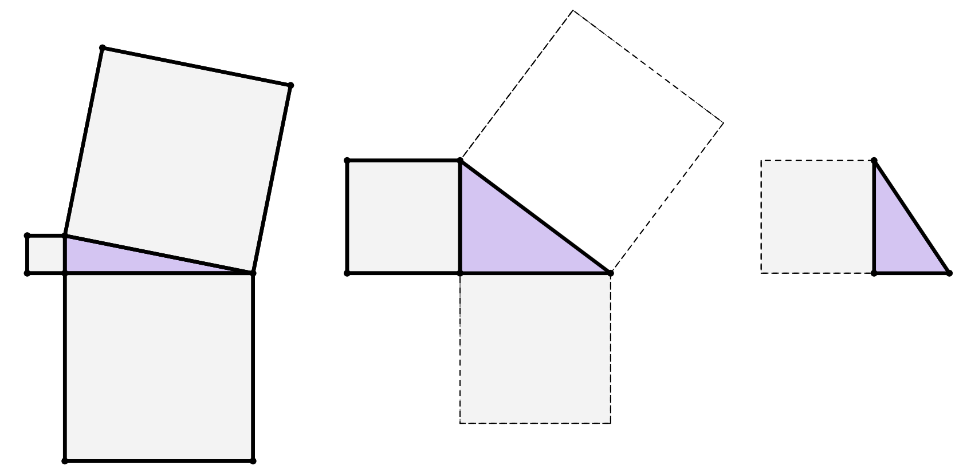
Squares from the sides of a triangle
2) By drawing on any missing squares first and calculating their areas, find the length of each side labelled with a letter.
area
29 cm²
area
275 cm²
b cm
15 cm
25 cm
c cm
a cm
30 cm
15 cm

Slide 19
Squares from the sides of a triangle
1) Find the area of each unlabelled square.
29 cm
400
cm²
441
cm²
area
570 cm²
114 cm²
170 cm²
841 cm²
144 cm²
400 cm²
12 cm
20 cm
20 cm
area
30 cm²

Slide 20
Squares from the sides of a triangle
2) By drawing on any missing squares first and calculating their areas, find the length of each side labelled with a letter.
625 cm²
625 cm²
area
29 cm²
225 cm²
25 cm
400 cm²
area
275 cm²
b cm
15 cm
25 cm
c cm
a cm
30 cm
20 cm
15 cm
14 cm
900 cm²
196 cm²
225 cm²

Slide 21
Length of a shorter side
Squares from the sides of a triangle
Using Pythagoras’ theorem to find a shorter side

Slide 22

Using Pythagoras’ theorem to find a shorter side
Pythagoras’ theorem can be used to calculate the hypotenuse of a triangle.
But can it be used to find the length of a shorter side?
23 cm
9 cm
x cm
Sam
I’m not sure, let’s substitute the side lengths into Pythagoras’ theorem and find out.
Laura
Pythagoras’ theorem: a² + b² = c²

Slide 23
Using Pythagoras’ theorem to find a shorter side
Okay, so should the letter x go on the right-hand side of the Pythagoras’ theorem formula, since it’s the unknown side?
23 cm
9 cm
x cm
Sam
No, definitely not!
Remember, it must always equal the square of the hypotenuse! Whether the hypotenuse is a known length or not!
Laura
Pythagoras’ theorem: a² + b² = c²

Slide 24
Using Pythagoras’ theorem to find a shorter side
Pythagoras’ theorem: a² + b² = c²
23 cm
9
2
+
x
2
=
23
2
9 cm
x cm
Square both shorter sides, separately.
The sum of these squares is always equal to the square of the hypotenuse.

Slide 25
Using Pythagoras’ theorem to find a shorter side
Pythagoras’ theorem: a² + b² = c²
23 cm
9
2
+
x
2
=
23
2
9 cm
81
+
x²
=
529
x cm
− 81
− 81
=
−
x²
529
81
The square of a shorter side of the triangle is found by subtracting, or finding the difference between, the square of the hypotenuse and the square of the other shorter side.

Slide 26
Using Pythagoras’ theorem to find a shorter side
Pythagoras’ theorem: a² + b² = c²
23 cm
9
2
+
x
2
=
23
2
9 cm
81
+
x²
=
529
x cm
− 81
− 81
21.17 cm
=
−
x²
529
81
x²
=
448
x²
=
448
=
21.17

Slide 27




Using Pythagoras’ theorem to find a shorter side
Whose first step to calculate the length r is correct?
r² + 10² = 18²
18 cm
r cm
18² + 10² = r²
Jun
Sofia
10 cm
10² + r² = 18²
Can you come up with any other correct ways of writing this first step?
18² = 10² + r²
18² = r² + 10²
10² = 18² + r²
Izzy
Alex

Slide 28
Using Pythagoras’ theorem to find a shorter side
Which of these are the correct calculations for and value of p²?
p cm
15 cm
a
24² + 15²
f
801
24² − 15²
351
24 cm
b
g
c
24 − 15
h
9
d
576 − 225
e
576 + 225

Slide 29
Using Pythagoras’ theorem to find a shorter side
I’m sure this is the correct calculation to find the missing length, c.
c cm
This is because the missing length is labelled with the letter c, so it must be the hypotenuse.
14 cm
16 cm
Andeep
It has no connection to the c in the triangle, which is clearly not the hypotenuse, since it’s obviously not opposite the right angle.
I think that’s wrong.
The c in the Pythagoras’ theorem formula represents the hypotenuse, but can be replaced by any other letter.
Pythagoras’ theorem: a² + b² = c²
16
2
+
14
2
=
c
2
Laura

Slide 30
Using Pythagoras’ theorem to find a shorter side
Yikes, that seems like an easy mistake to make.
To stop myself from getting confused by the letters, I might remember Pythagoras’ theorem like this …
c cm
14 cm
16 cm
Andeep
2
2
shorter side
+
other shorter
side
=
2
hypotenuse
c
2
+
14
2
=
16
2

Slide 31
Using Pythagoras’ theorem to find a shorter side
An effective way of finding the length of a shorter side of a right-angled triangle involves a combination of rearranging an equation and the efficient use of a calculator.
68 cm
39 cm
t cm

Slide 32
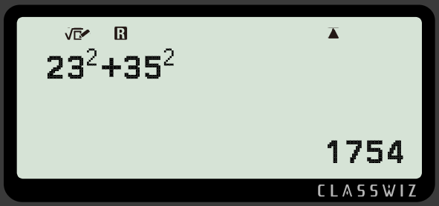
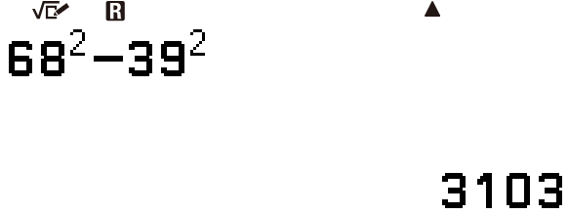

Using Pythagoras’ theorem to find a shorter side
t
2
+
39
2
=
68
2
2
2
2
68 cm
t
=
68
−
39
39 cm
t
2
=
3103
t cm
buttons to press
calculator screen

Slide 33
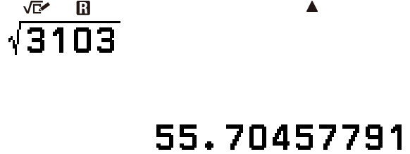

Using Pythagoras’ theorem to find a shorter side
t
2
+
39
2
=
68
2
55.7 cm
2
2
2
68 cm
t
=
68
−
39
39 cm
t
2
=
3103
t cm
t
=
55.7
buttons to press
calculator screen

Slide 34
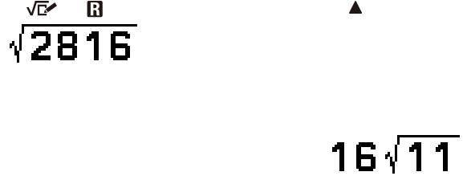
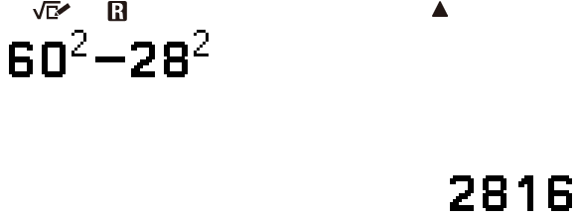
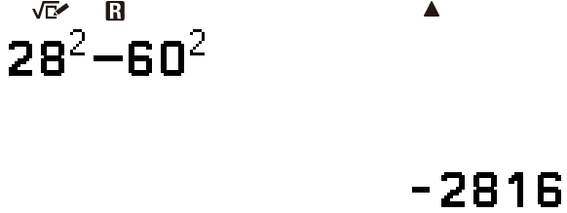
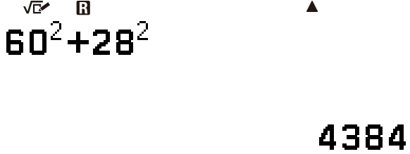
Using Pythagoras’ theorem to find a shorter side
A triangle has two shorter sides of length 28 cm and w cm, and a hypotenuse of 60 cm.
Whose calculator display shows a correct step to calculate the value of w?
Sofia
Jun
Izzy
Alex

Slide 35
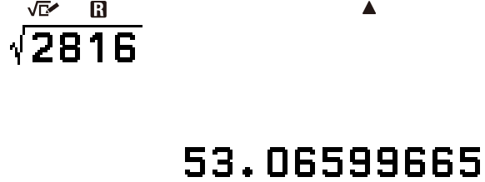

Using Pythagoras’ theorem to find a shorter side
A triangle has two shorter sides of length 28 cm and w cm, and a hypotenuse of 60 cm.
Whose calculator display shows a correct step to calculate the value of w?
Sofia
We can convert this surd form of an answer into a decimal form by changing the format display of the answer.

Slide 36
Using Pythagoras’ theorem to find a shorter side
1) Fill in all the blanks to complete the method to calculate the length of side e, rounded to 1 decimal place.
2
+
2
=
2
+
=
22 cm
e cm
=
−
=
459
=
=
5 cm

Slide 37
Using Pythagoras’ theorem to find a shorter side
2) Which of these are correct representations of Pythagoras’ theorem to find the length of side c?
3) Using Pythagoras’ theorem, show fully that the value of w cm is 58.52 cm when rounded to 2 decimal places.
81 cm
21 cm
c cm
56 cm
w cm
9 cm
4) Show that the perimeter of this triangle is 84 cm.
a
b
c² = 21² + 9²
c² = 21² − 9²
37 cm
c
d
21² = 9² + c²
21² = c² + 9²
e
f
21² = 9² − c²
21² = c² − 9²
12 cm

Slide 38
Using Pythagoras’ theorem to find a shorter side
5) Match each triangle to a calculation and answer to find the length of its missing side.
b)
a)
b cm
18 cm
c)
31 cm
2 cm
12 cm
13 cm
c cm
34 cm
a cm
d
e
f
g
calculation
34² − 31²
169 − 2²
165
324 − 144
h
i
j
length of missing side
13.96 cm
13.42 cm
12.84 cm

Slide 39
Using Pythagoras’ theorem to find a shorter side
1) Fill in all the blanks to complete the method to calculate the length of side e, rounded to 1 decimal place.
e
2
+
5
2
=
22
2
e²
+
25
=
484
22 cm
e cm
e²
=
484
−
25
e²
=
459
e
=
459
=
21.4 (1 d.p.)
5 cm

Slide 40
Using Pythagoras’ theorem to find a shorter side
2) Which of these are correct representations of Pythagoras’ theorem to find the length of side c?
21 cm
c cm
9 cm
a
b
c² = 21² + 9²
c² = 21² − 9²
c
d
21² = 9² + c²
21² = c² + 9²
e
f
21² = 9² − c²
21² = c² − 9²

Slide 41
Using Pythagoras’ theorem to find a shorter side
3) Using Pythagoras’ theorem, show fully that the value of w cm is 58.52 cm when rounded to 2 decimal places.
4) Show that the perimeter of this triangle is 84 cm.
81 cm
37 cm
56 cm
w cm
12 cm
56² + w² = 81²
Let the missing length be called x.
w² = 81² − 56²
x² = 37² − 12² = 1225
w² = 3425
x = 1225 = 35
w = 3425 = 58.5234996
Perimeter = 12 cm + 37 cm + 35 cm
w = 58.52, after rounding.
Perimeter = 84 cm

Slide 42
Using Pythagoras’ theorem to find a shorter side
5) Match each triangle to a calculation and answer to find the length of its missing side.
b)
a)
b cm
18 cm
c)
31 cm
2 cm
12 cm
13 cm
c cm
34 cm
a cm
g
d
e
324 − 144
34² − 31²
169 − 2²
i
h
f
13.42 cm
13.96 cm
165
j
12.85 cm

Slide 43
Length of a shorter side
A square from a shorter side of a right-angled triangle is equal in area to the difference between the area of the square from the hypotenuse and the square from the other shorter side.
Pythagoras’ theorem can be used to calculate the length of a shorter side of a triangle after rearranging an equation.

Slide 44

© Oak National Academy 2024.
Produced in partnership with Mathematics in Education and Industry.
Licensed on the Open Government Licence v3.0, except where otherwise stated. See Oak terms and conditions.

